Slide 1
Crane Aerospace & Electronics
TI digital design seminar de-brief
November 2013

Slide 2
Analog versus digital
 | Analog | Digital
control bandwidth | high | limited by sampling
cost | historically low | getting cheaper
available expertise | high | low
flexibility | hardware based-inflexible | S/W programmable
lifetime operation | component drift/aging/tol | relatively insensitive
scalability | limited practical topologies due to complexity | low complexity cost when scaling
numerical problem | none | architecture dependent
switching frequency | very high | limited to system clock
Reliability | Military Grade Available | Military Grade Available
Rad Hard | Well tested | Limited testing

Slide 3
Why go digital?
Easy to scale existing design through software
Less sensitive to environmental changes
Saves space for more complex converters

Slide 4
Why TI’s C2000
Large support community
It’s cheap
High-Resolution PWM
Small form factor

Slide 5
How cheap
Device Series | CPU Speed | Memory | Architecture Features | Starting Price
Piccolo F2806x | 90 MHz | 128kB to 256kB | Floating-point, VCU*,CLA*,DMA | $4.95
Piccolo F2805x | 60 MHz | 64kB to 128kB | Fixed-point, CLA, PGAs, Windowed Comparators | $3.25
Piccolo F2803x | 60 MHz | 64kB to 128 kB | Fixed-point, CLA* | $2.79
Piccolo F2802x | 40-60 MHz | 16kB to 64 kB | Fixed-point | $1.85

Slide 6
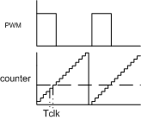

Why high resolution PWM matter
Basic digital PWM (counter based)
$$f_{clk}=100MHz$$
$$f_{s}=500kHz$$
$$\frac{f_{clk}}{f_{s}}=200 steps$$
$$resolution=\frac{50V}{200 steps}=250mV/step$$
High Res PWM
$$T_{step(piccolo datasheet)}=150ps$$
$$f_{hrpwm}=\frac{1}{150ps}$$
$$\frac{f_{hrpwm}}{f_{s}}=13333 steps$$
$$resolution=\frac{50V}{13333 steps}=4mV/step$$

Slide 7

Will it fit
TMS320F2803 (S-PVQFN-N56)
$$0.275 in. x 0.275 in.$$
$$Area=0. 076 {in}^{2}$$
Replacement area
 | MFX
 | qty | area (in2)
UCC2897A | 1 | 0.027
TLC2272Y | 1 | 0.0038
0402 res | 25 | 0.02
0402 cap | 3 | 0.0024
0603 cap | 7 | 0.013
1N4148 | 6 | 0.0016
2N2907A | 5 | 0.0024
 |  | 0.070
 | SMTR
 | qty | area (in2)
LM119 | 1 | 0.005
MC35072 | 1 | 0.005
0402 res | 30 | 0.026
0504 cap | 11 | 0.022
1N4148 | 11 | 0.003
LM158 | 1 | 0.003
 |  | 0.064

Slide 8
Design Flow
Place poles and zeros in transfer function
Compensate for digital phase margin erosion
Convert transfer function to z-domain
Convert z-domain to discrete time domain
Implement time-difference equation in code

Slide 9
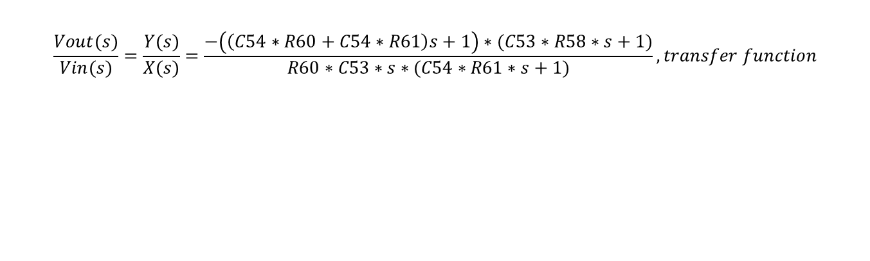
Compensation example
SMTR Voltage Compensation
$$\frac{Vout(s)}{Vin(s)}=\frac{Y(s)}{X(s)}=\frac{−\left(\left(C54∗R60+C54∗R61\right)s+1\right)∗(C53∗R58∗s+1)}{R60∗C53∗s∗(C54∗R61∗s+1)}, transfer function$$

Slide 10

S to Z to N
$$K=\frac{(C54∗R60+C54∗R61)(C53∗R58)}{C53∗R60∗C54∗R61}, a_{1}=\frac{1}{C54∗R60+C54∗R61}, a_{2}=\frac{1}{C53∗R58}, b_{2}=\frac{1}{C54∗R61}$$
$$\frac{Y(s)}{X(s)}=K\frac{(s+a_{1})(s+a_{2})}{s(s+b_{2})}, s domain$$
$$\frac{Y[z]}{X[z]}=\frac{99\frac{1}{z^{2}}−200\frac{1}{z}+101}{−15\frac{1}{z^{2}}+32\frac{1}{z}−17}, z domain$$
$$T_{s}=\frac{1}{2πf_{s}}$$
$$y\left[n\right]=−\frac{1}{17}∙\left(99∙x\left[n−2\right]−200∙x\left[n−1\right]+101∙x\left[n\right]+15∙y\left[n−2\right]−32∙y\left[n−1\right]\right), discrete time$$
Defense Ground & Airborne Systems 80%
Defense

Slide 11
Recommendation
Buy piccolo prototype
Piccolo controlSTICK - $39
Piccolo USB Experimenter’s Kit - $79
Implement controller on forward topology
Compare performance with analog controller

Slide 12

The Crane Advantage!
for more information please visit CraneAE.com

